Slide 1
Mentor:- Mr. Mandeep Singh Presented by:- Technical Trainer Adarsh Sisodia(201500030) Aryan Pokhriyal(201500155) Department of Computer Science of Kumkum Singh(201500360) Engineering Sanjhi Dixit(201500618)
StudySavvy

Slide 2
1. Introduction 2. About the project 3. Objective 4. Project Overview 5. Project Description 6. Conclusion
AGENDA

Slide 3
Introduction
The world of education has evolved rapidly in recent times, with a shift towards online and remote learning becoming more prevalent than ever. As part of this digital revolution, I have developed an e-learning website, an innovative platform that provides a dynamic and interactive learning experience for students, teachers, and learners of all ages.
The e-learning website is designed to offer a comprehensive and engaging online learning environment that is accessible anytime, anywhere. Through this platform, learners can access a wide range of educational resources, including lessons, courses, tutorials, quizzes, and interactive learning modules, that are specifically tailored to their individual needs and learning styles.

Slide 4
objective
The primary objective of this project is to create a user-friendly and intuitive e-learning website that enhances the learning experience for users. The website incorporates modern web design principles and advanced technologies to ensure seamless navigation, interactivity, and engagement. It also includes features such as progress tracking, assessments, and user feedback to provide a personalized and effective learning experience.

Slide 5
Project overview
Steps to access the website:
Go to the website link.
Choose the course.
Register for the course and start learning.

Slide 6
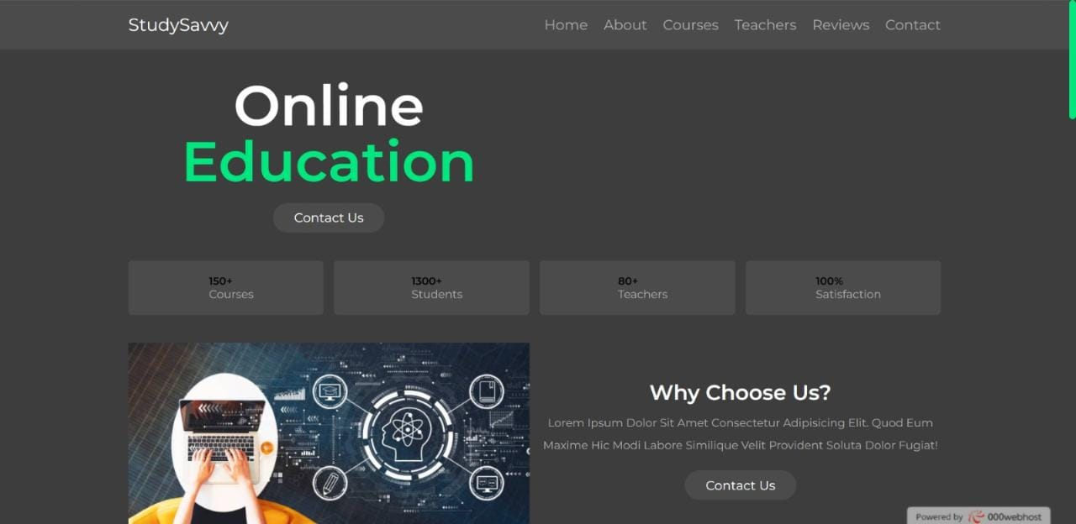
Project discription
Home Page:
The Home page is the base page of our website it will allow the user to travel through all the pages and allow users to experience all the opportunities.

Slide 7
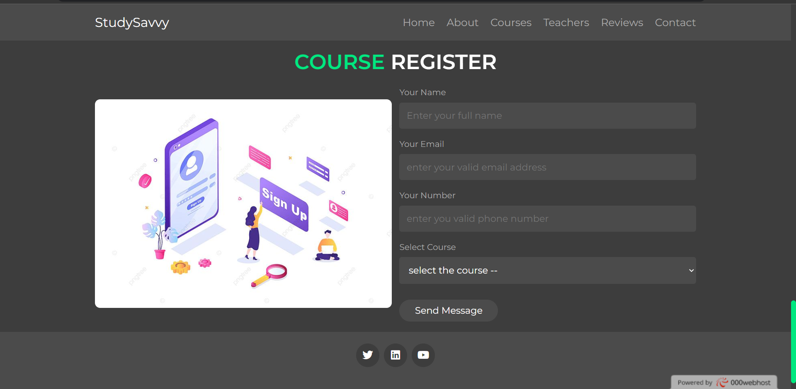
Course Registration:
Learners can select any course and register in the courses by giving there Name, E-mail, Contact no. and Course Name.

Slide 8
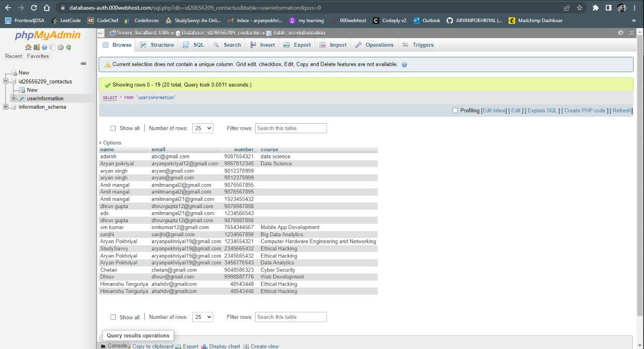
Database :

Slide 9
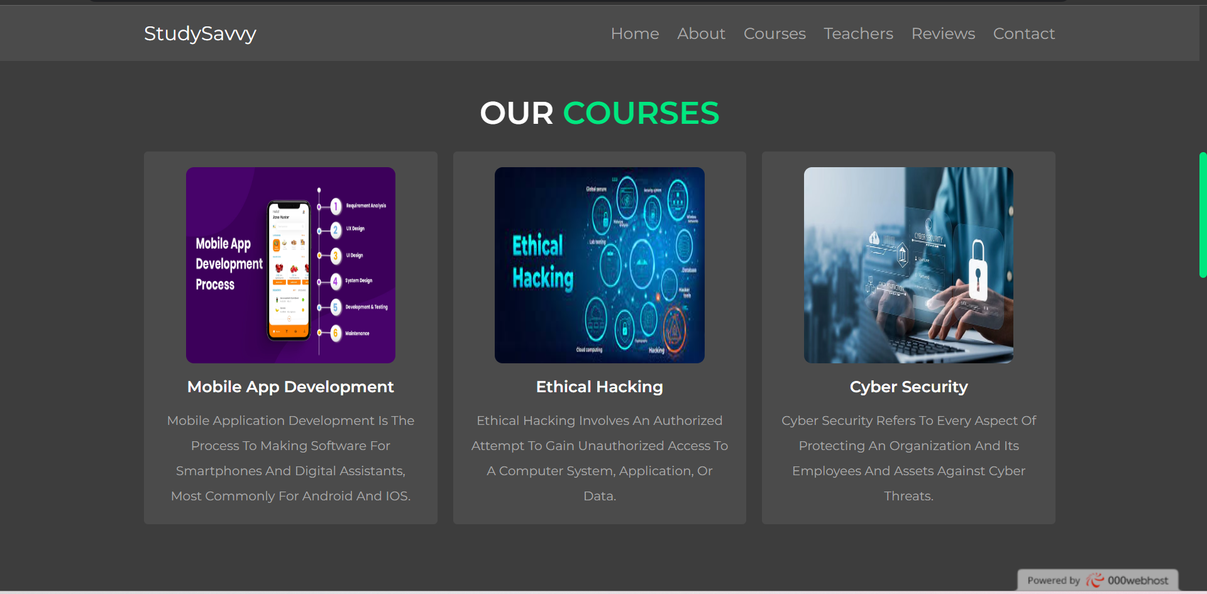
Courses Provided:

Slide 10
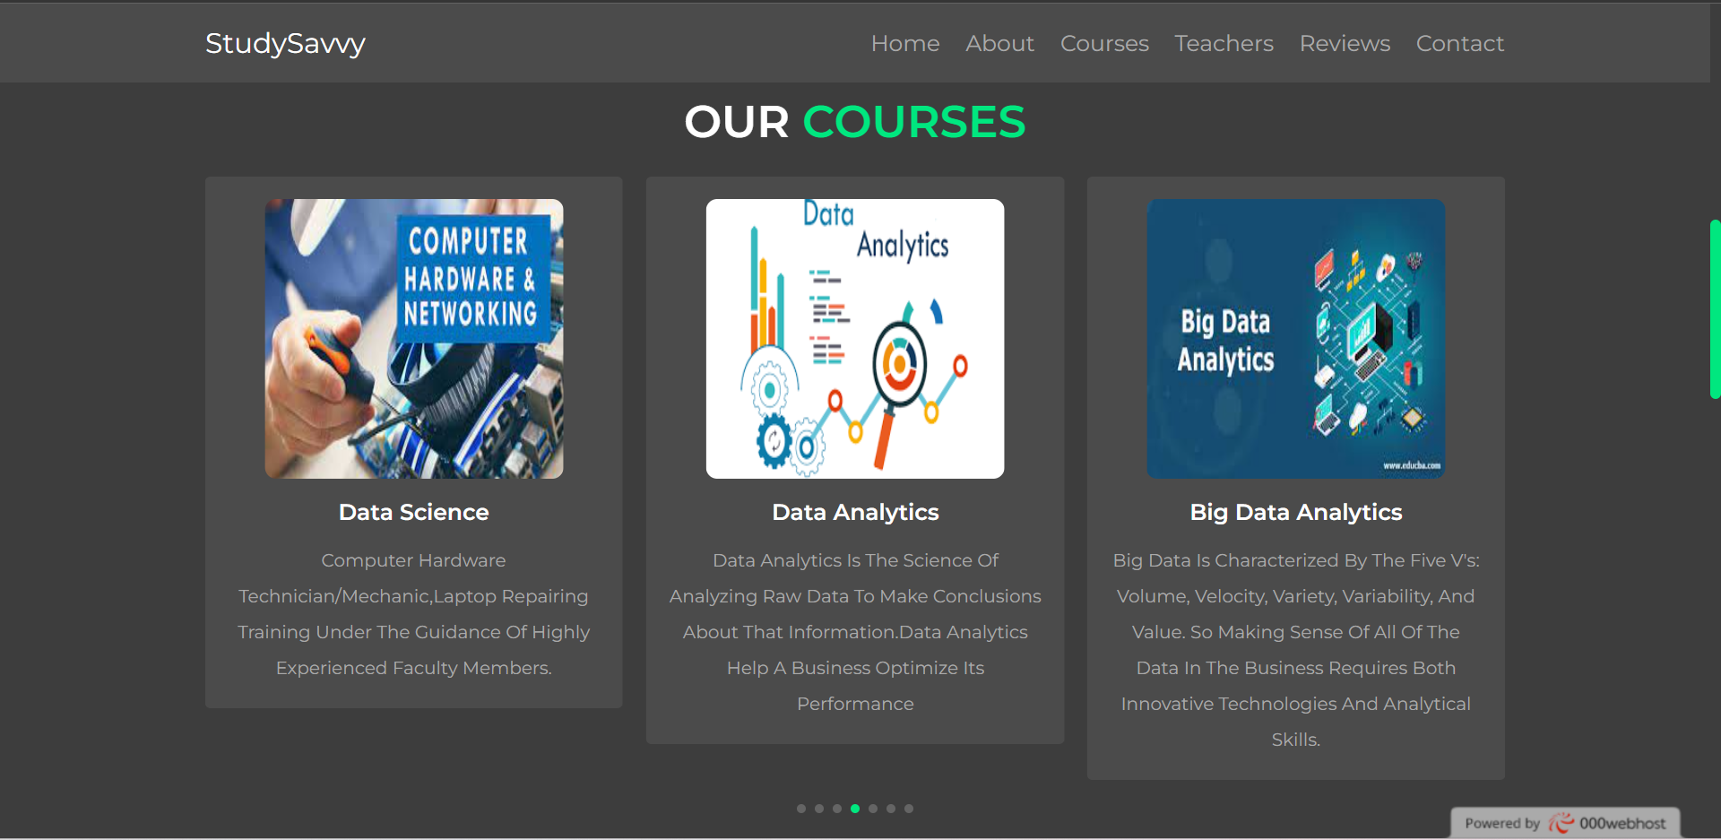

Slide 11
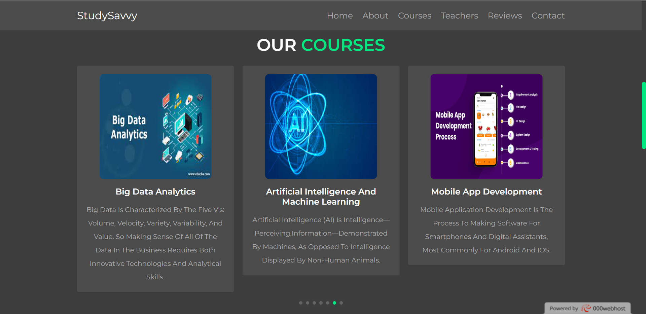

Slide 12
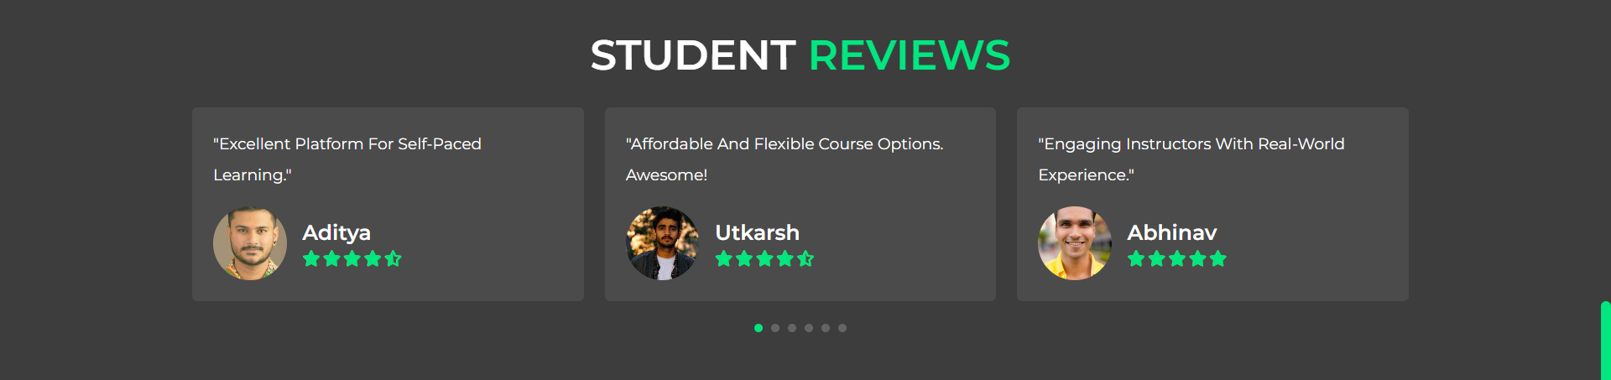
Review Page:

Slide 13
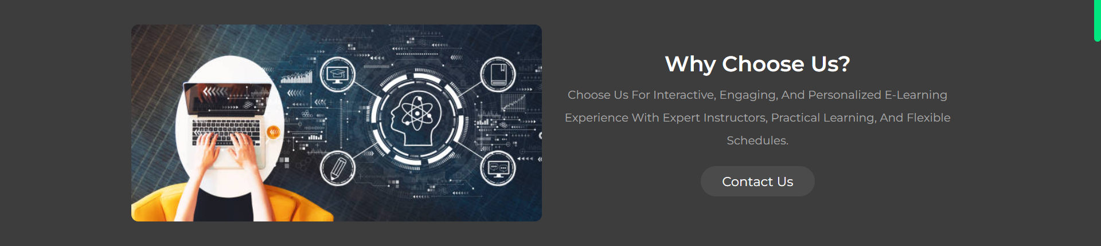
About Page:

Slide 14
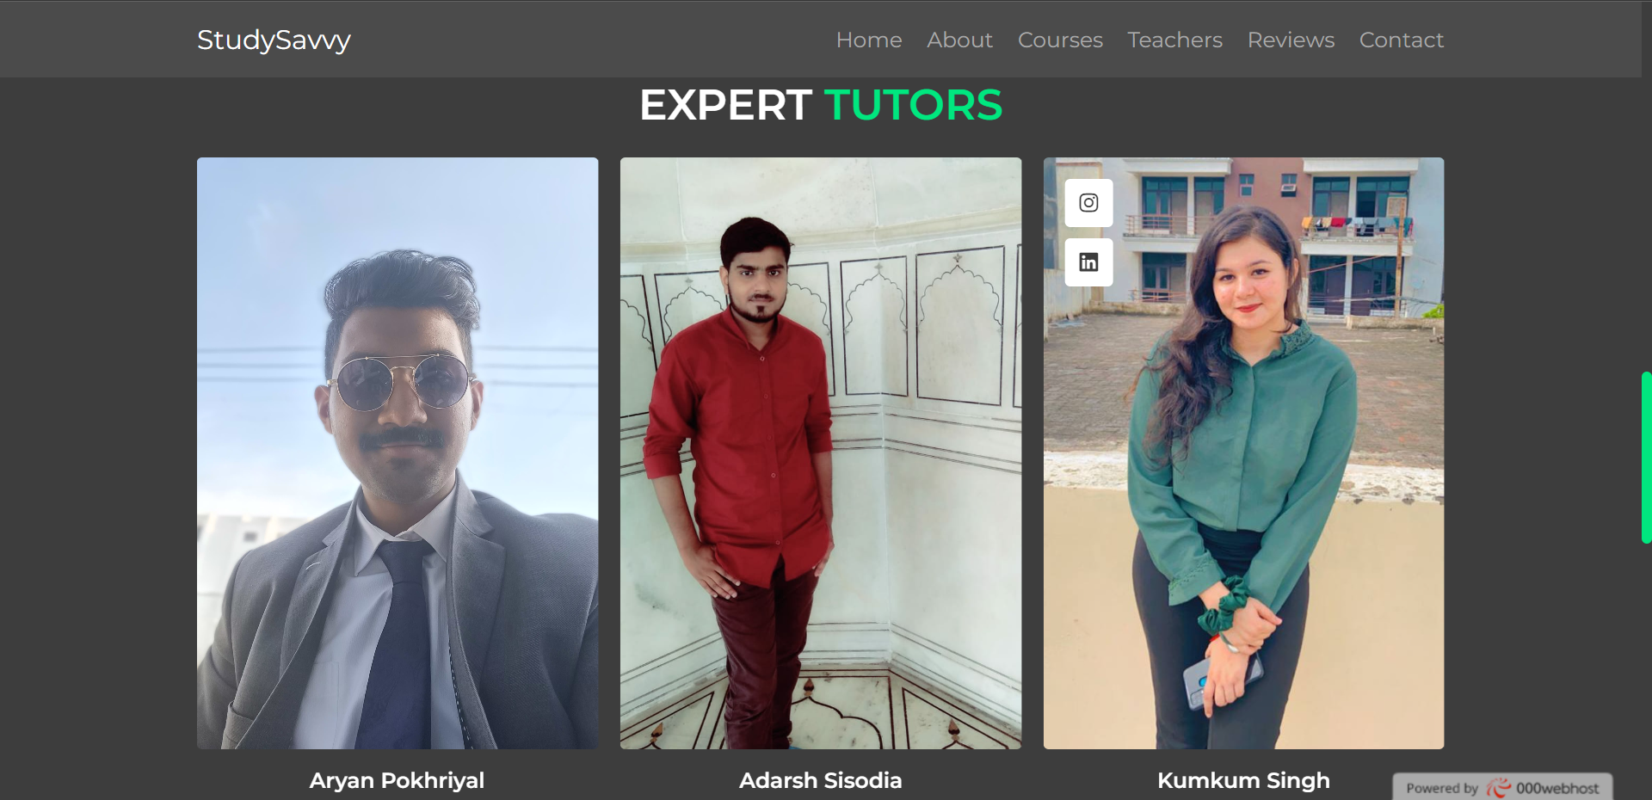
Expert Tutors Page:

Slide 15
Overall, this project aims to contribute to the field of education by providing an innovative and effective platform for online learning. The e-learning website is intended to empower learners with the knowledge and skills they need to succeed in today's digital world, and I am excited to share the details of this project in this report.
conclusion

Slide 16
Thank you

